Slide 1
Mode Solving AND FDFD Simulating of Metallic Nano Cylindrical Waveguide
Student：楊翔渝
Advisor： Prof. Shih-Hui Chang
Date ：2010/08/05

Slide 2
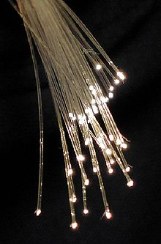
Motivation
Surface plasmon behavior
Single interface
Parallel plate
Cylindrical Waveguide
FDFD mode Simulating
FDFD Theory
Simulation Result
Discussion & Conclusion
115/11/08
FDFD mode Simulating

Slide 3
Motivation
WG -> Cutoff
Small size -> High cutoff
Nowadays chips size around Nano scale!
Metal waveguide Surface Plasmon Dispersion Relation
Can wave propagate below cutoff frequency?
115/11/08
FDFD mode Simulating

Slide 4
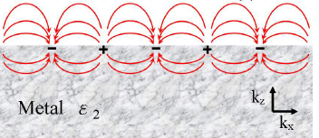

Single Interface
Ion behavior near interface ：
TM (Transverse magnetic ) wave excited ONLY
Parallel to interface ：Proton alternative distribute with Ion
Perpendicular to interface ：One mass of Positive charge and
Negative charge exchange with
each in the range about
115/11/08
FDFD mode Simulating

Slide 5
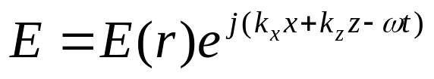
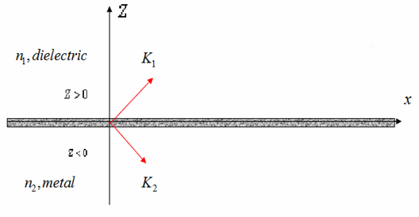
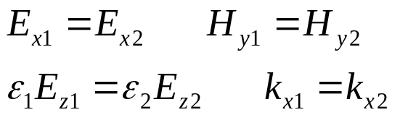
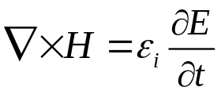
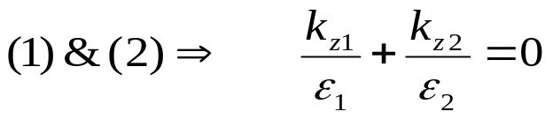
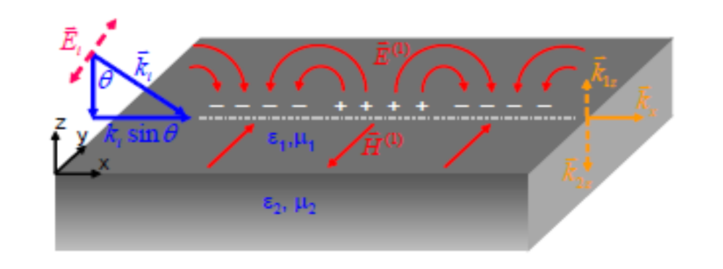
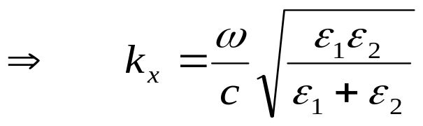
Single Interface
TM wave condition (Only)
Matching boundary condition ：
Maxwell eq ：
Permeability usually equal to 1
Dispersion Relation at
interface
z
K₁
n₁, dielectric , z>0
x
K₂
n₂, metal , z<0
115/11/08
FDFD mode Simulating

Slide 6
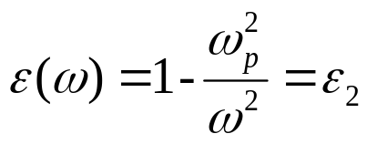

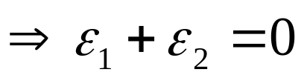
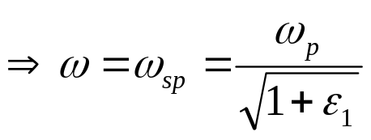
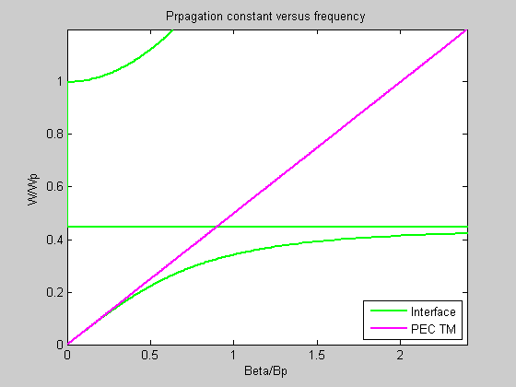

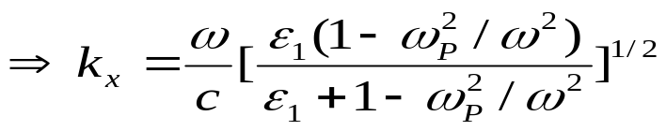
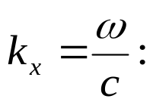
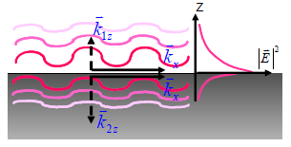
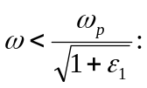
Single Interface
Dispersion Relation
Using Drude free electron model in metal：
Max
Propagation Profile：
輻射性表面電漿
light line (ε=1)
nonradiative surface
plasmon
115/11/08
Surface plasmon behavior

Slide 7
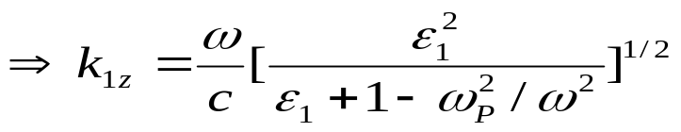
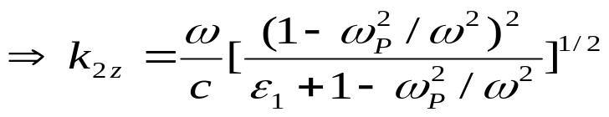
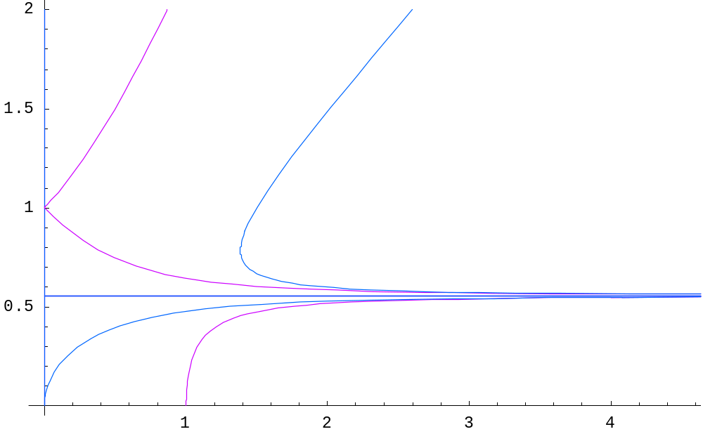

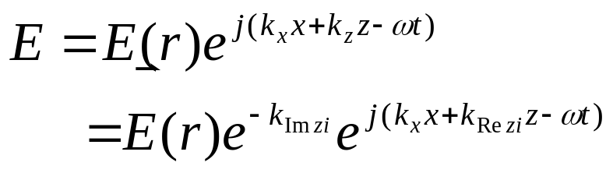

Single Interface
Perpendicular K vector behavior
If express
ω
Re[k_{z2}]
Re[k_{z1}]
Im[k_{z1}]
Im[k_{z2}]
115/11/08
Surface plasmon behavior
Re[k_{zi}],i=1,2;Im[k_{zi}],i=1,2

Slide 8
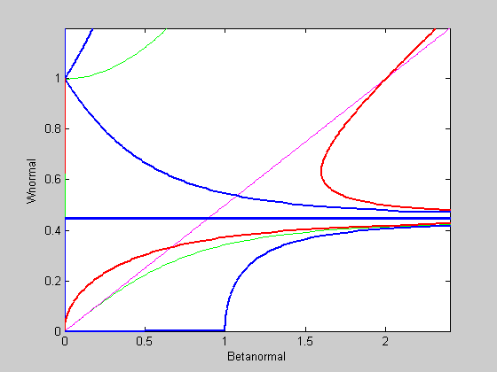
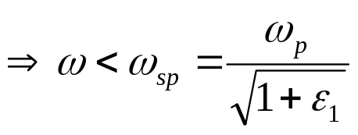
Single Interface
Dispersion Relation
At same frequency range：
輻射性表面電漿
Re[k_{z2}]
Re[k_{z1}]
light line
Im[k_{z1}]
Im[k_{z2}]
Re[k_{zi}],i=1,2;Im[k_{zi}],i=1,2
115/11/08
nonradiative surface plasmon

Slide 9



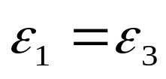
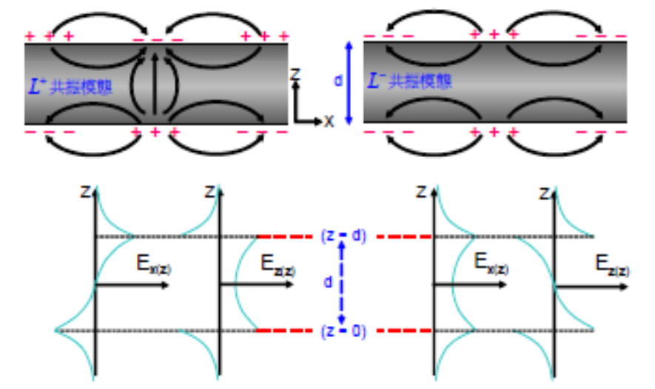
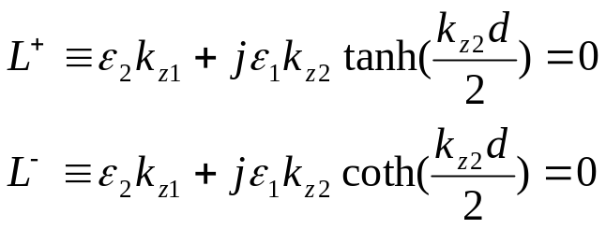

Parallel plate
b
y
z
d
x
Two interface in the coupled range (nano scale)
By matching B.D .
If
115/11/08
FDFD mode Simulating

Slide 10


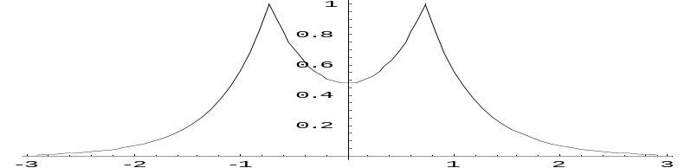
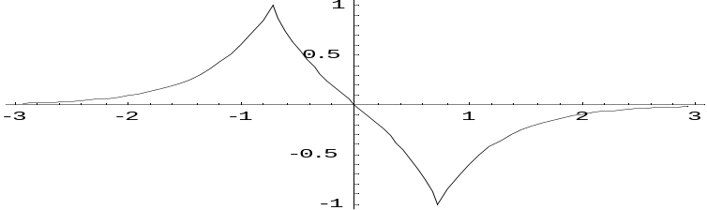


Parallel plate
z
0:air
IMI case
MIM case
x
d
1 :metal
0:air
intensity
intensity
z
z
0 :metal
z
d
1: air
0 :metal
x
intensity
intensity
z
115/11/08
z
FDFD mode Simulating

Slide 11
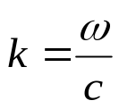

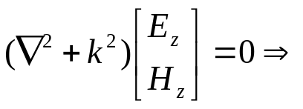

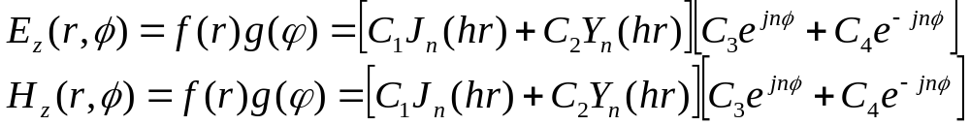

Cylindrical Waveguide
For PEC , Dielectric , Metal case
General solution of Cylindrical Wave Eq：
Get other component from by Maxwell eq
z
115/11/08
FDFD mode Simulating

Slide 12
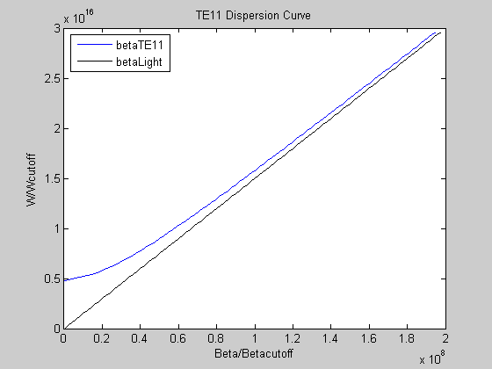
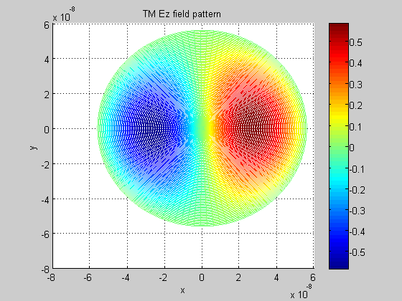

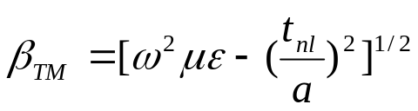
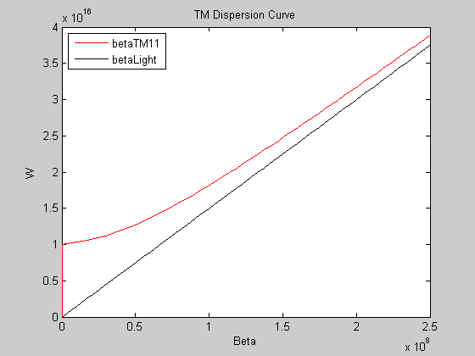
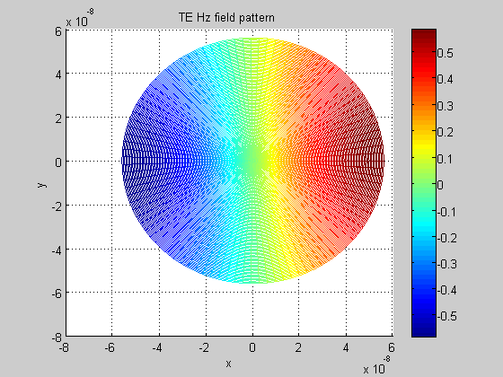

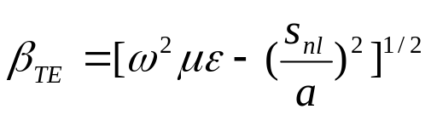
Cylindrical Waveguide
PEC case
TM mode DR
TE mode
115/11/08
FDFD mode Simulating

Slide 13

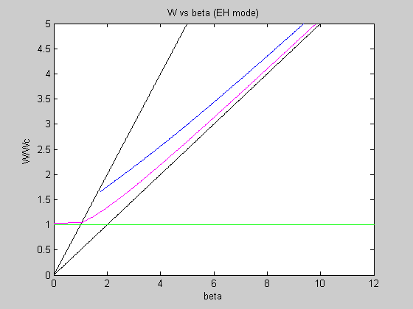
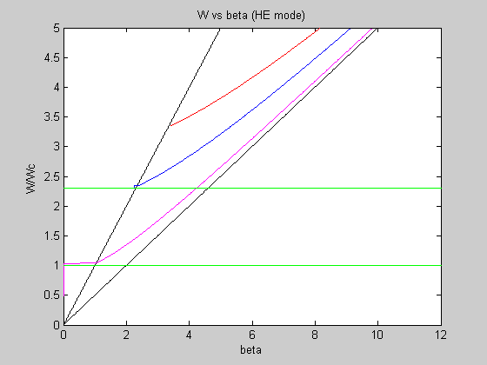
Cylindrical Waveguide
Dielectric case
Separate into two section ：Core (ε1) & Cladding(ε2)
Total Internal Reflection
Split into two mode ：HE & EH
Dispersion diagram：
115/11/08
FDFD mode Simulating

Slide 14

Cylindrical Waveguide
Metallic case
Compared with parallel plate WG’s Surface plasmon behavior
Same algorithm with Dielectric WG ,but adapted Drude model
Radius r=0.36*
Dispersion Diagram
115/11/08
FDFD mode Simulating

Slide 15
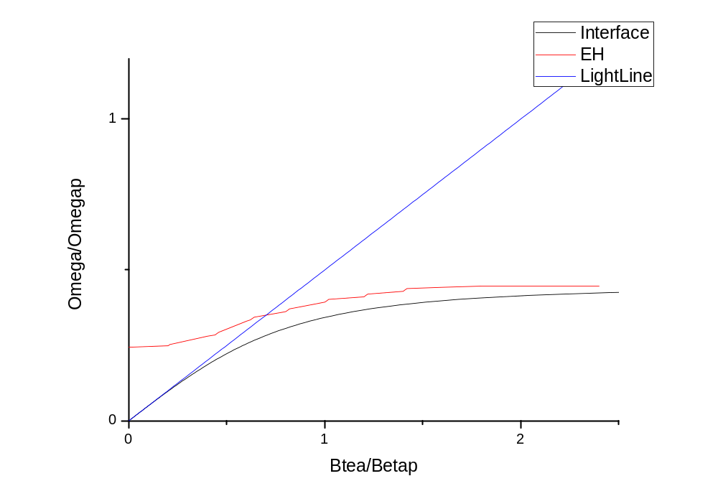
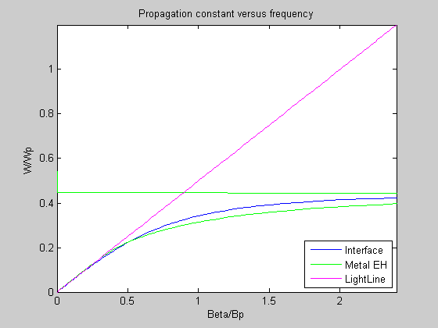
Cylindrical Waveguide
Dispersion Diagram Wcutoff=3.545*10^15
MIM EH IMI EH
115/11/08
FDFD mode Simulating

Slide 16
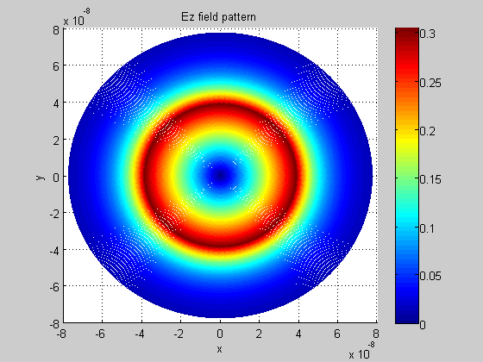

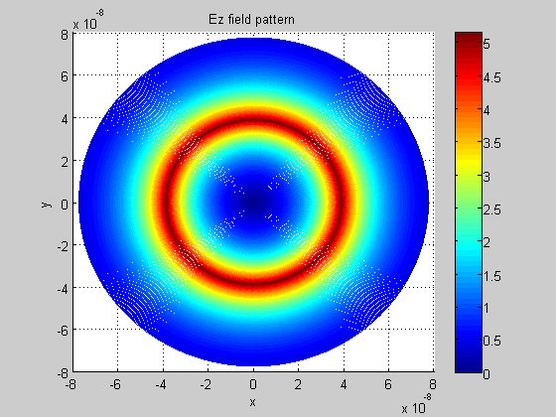

Cylindrical Waveguide
Metallic WG Mode Profile
MIM EH
Ez Hz
IMI EH
Ez Hz
115/11/08
FDFD mode Simulating

Slide 17
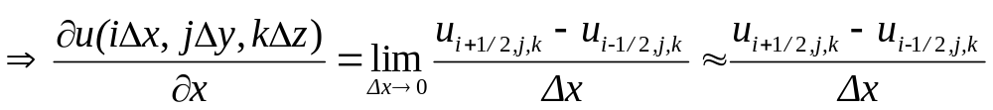
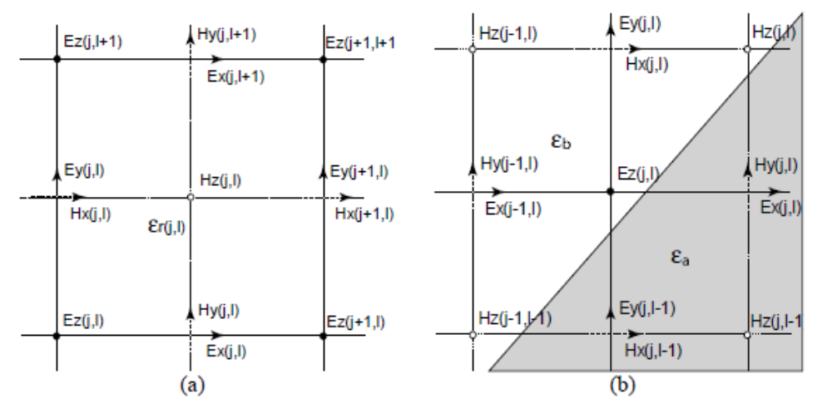
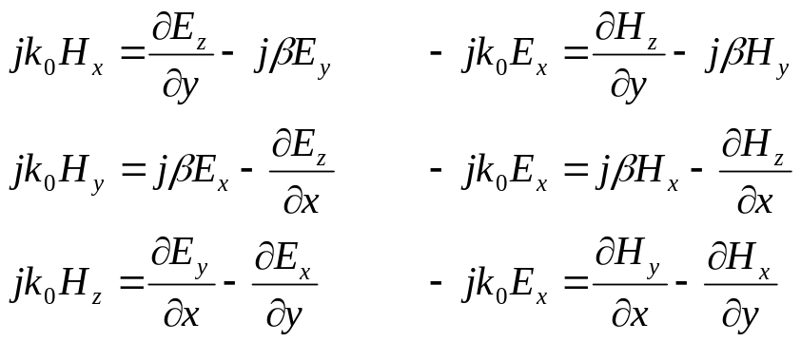
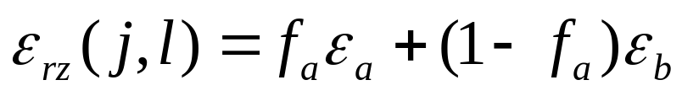
FDFD Theory
Grid constructing
Central difference
Using index average technique
115/11/08
FDFD mode Simulating

Slide 18
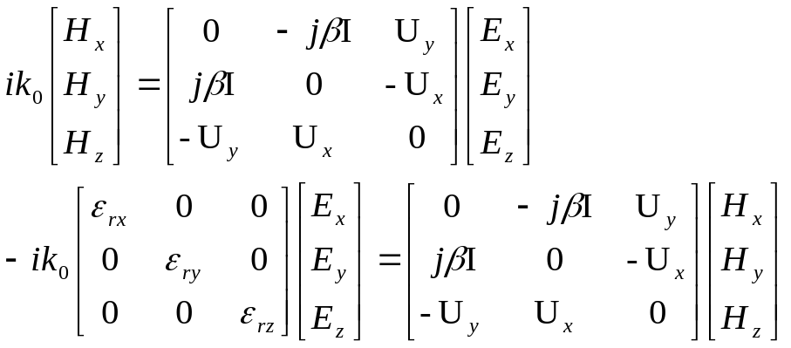
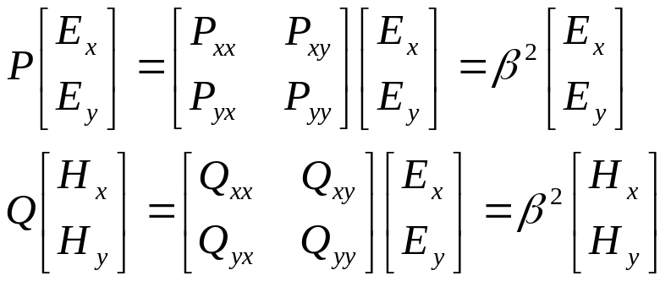
Eigen value Matrix
Start with Helmholtz equation ：
Adapting with FDFD theory
Get β
115/11/08
FDFD mode Simulating

Slide 19
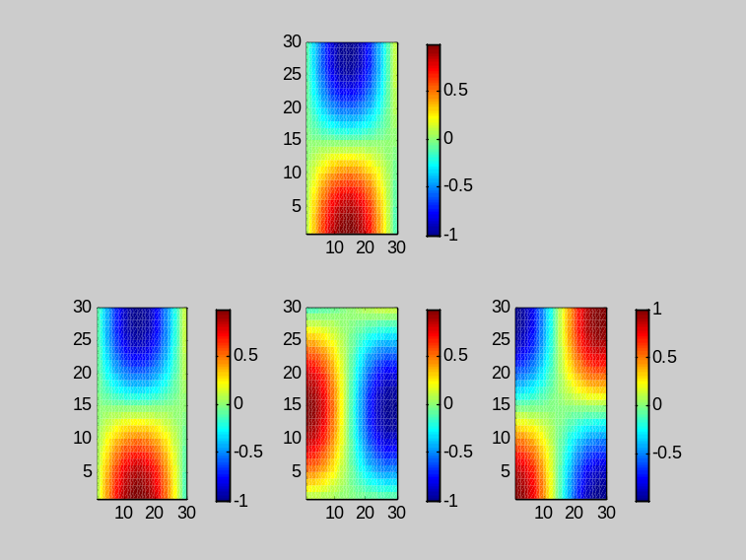


Simulation Result
Mode Profile
Mode profile tracing
FDFD Simulation
115/11/08
FDFD mode Simulating

Slide 20
Discussion & Conclusion
Plasmon Mode happened at the interface between Metal & Dielectric.
Compare with fiber or PEC WG ,Plasmon WG
have lower cutoff frequency with same size.
Among IMI & MIM structure , FDFD seem be a good way to solving mode.
115/11/08
FDFD mode Simulating

Slide 21
Future Work
Construct complete FDTD Method
115/11/08
FDFD mode Simulating

Slide 22
The End
Thank you for the Listening
115/11/08
FDFD mode Simulating

